Slide 1
Digital Twin of an Ego Vehicle in CARLA
Selected Topics in Computer Science

Slide 2
Table of contents
01
02
03
04
05
06
Introduction
Our tested Scenario
FMU Model
Carla Simulation
Integration Methods
Cloud - Connect

Slide 3

Team Members
Abdelrahman Helaly - Cloud
Hatem Mira - Integration
Mayar Sanad - FMU Model
Mohamed Hossam - Carla Simulation

Slide 4
01
Introduction

Slide 5
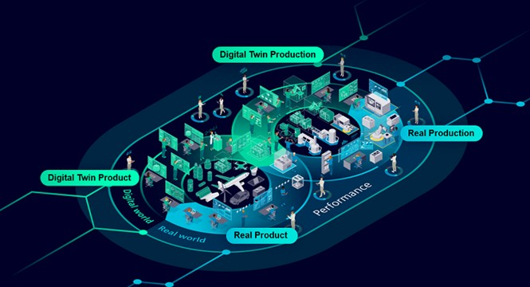
Digital Twin Overview
Has emerged as a transformative paradigm enabling real-time synchronization between physical assets and their virtual counterparts.
Real-time mapping allows engineers and researchers to monitor, simulate, and optimize system performance without physically intervening in the actual hardware.

Slide 6
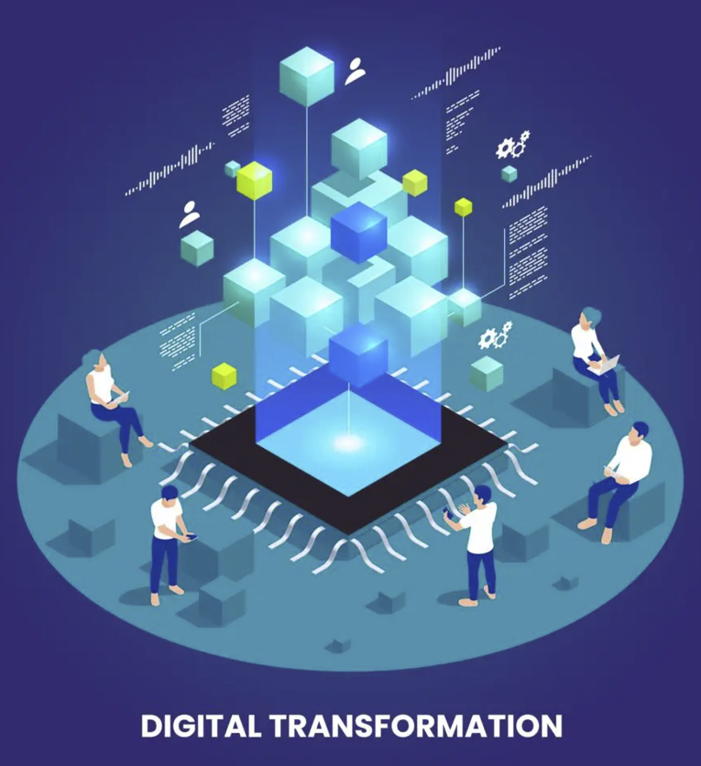
Digital Twin Benefits
Real-Time Monitoring
Predictive Maintenance
Cost Reduction
Improved Decision-Making
Enhanced Integration

Slide 7
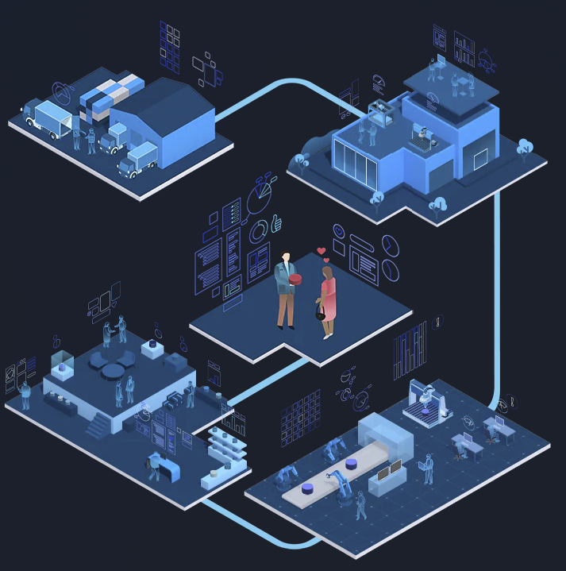
Digital Twin Challenges
Synchronization
Computational Overhead
Security & Privacy
Interoperability Issues
Scalability & Maintenance

Slide 8
02
Our Scenario

Slide 9
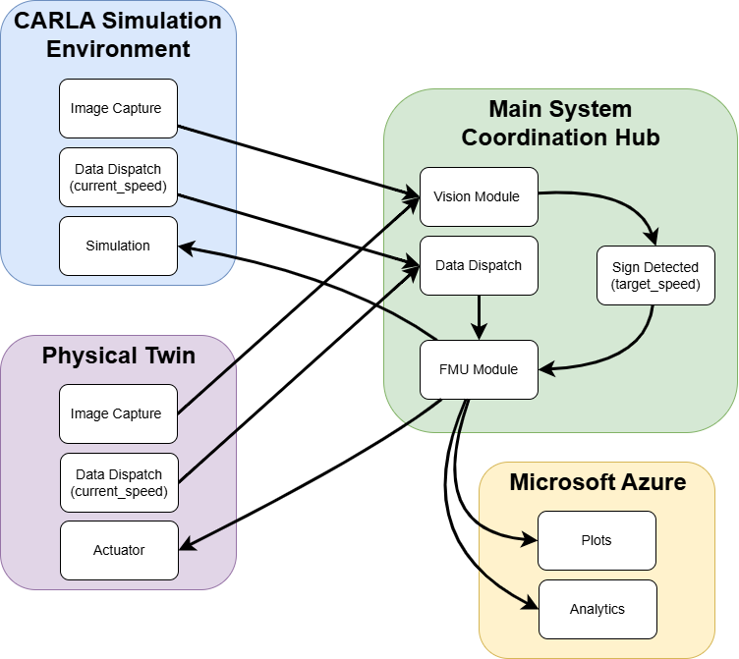
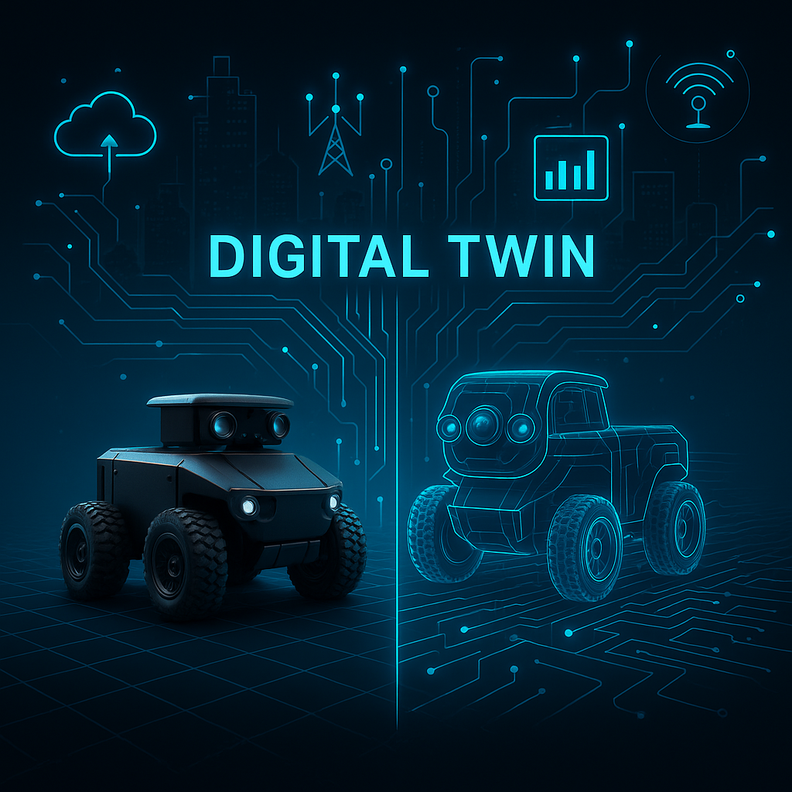
Case Scenario

Slide 10
03
FMU Model

Slide 11
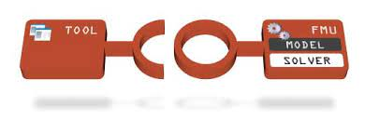
Overview
What is FMU ?
Our goal:
Encapsulated dynamic systems that are packaged according to a tool-independent standard interface called Functional Mockup Interface.
To model a braking system using Simulink and export it as a Co-Simulation FMU to integrate with our ROS-based framework.

Slide 12
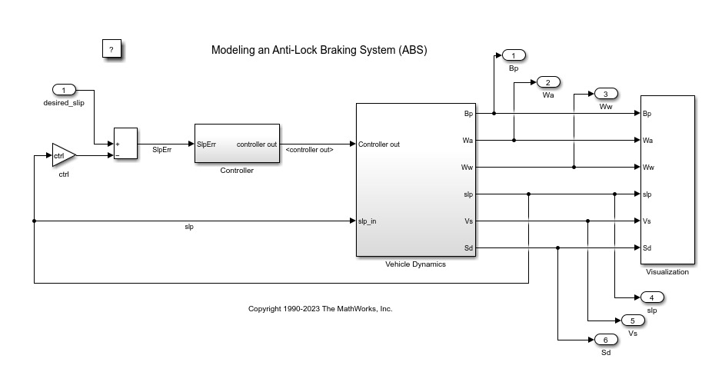
Simulink Model
We simulate brake torque and varying wheel speed under different slip conditions.
The model uses Bang-bang control to regulate the brake pressure based on slip error.

Slide 13
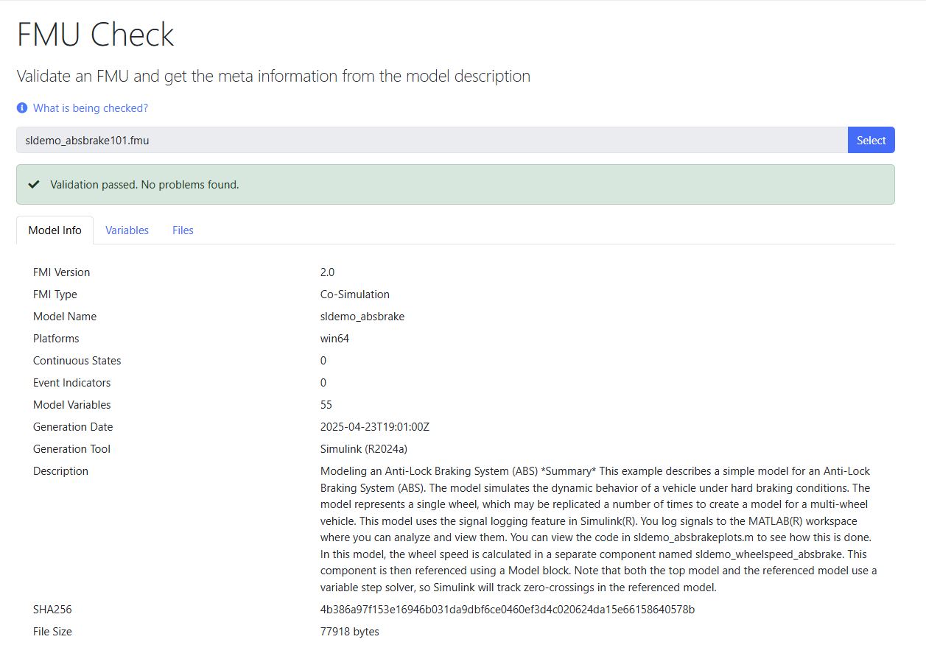
FMU Export & Validation
We used FMU-Check to validate the readiness of our model for integration as well as verify inputs, outputs, and metadata.
Files:
model.png
modelDescription.xml
binaries/win64/sldemo_absbrake.dll
binaries/linux64/sldemo_absbrake.so

Slide 14
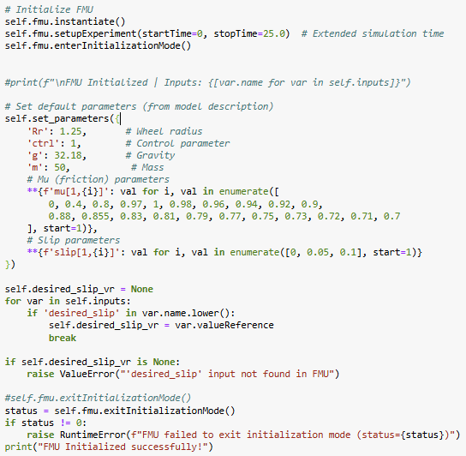
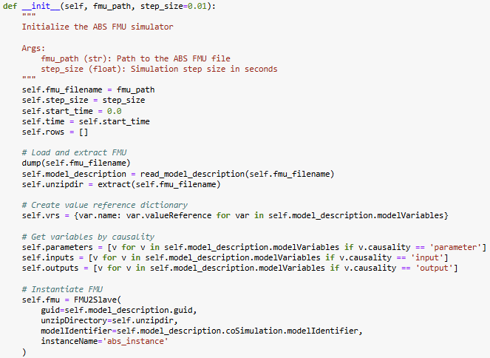
Python Code with FmPy
Initialization:
Extract FMU, load metadata, classify variables, and instantiate for co-simulation.

Slide 15
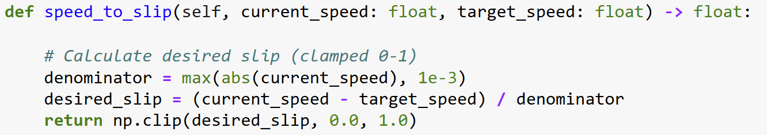
Python Code with FmPy
Slip Calculation:
Developed a function that maps current_speed & target_speed (inputs from Carla) to the desired_slip, which is the input to our ABS model.

Slide 16
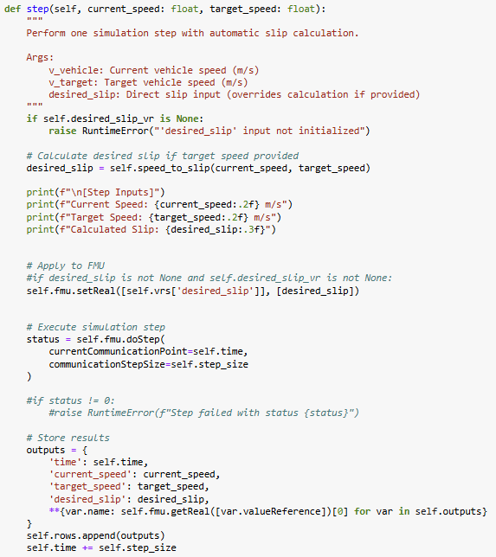
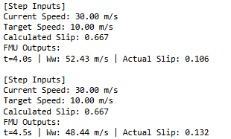
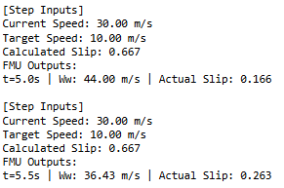
Python Code with FmPy
Simulation Step:
We calculate the desired_slip and apply it as an input to the FMU, then advance the simulation by one step.
Output values are captured to be plotted, and the current parameters for each time instance are printed.

Slide 17
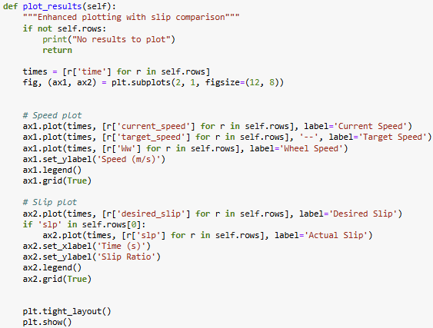
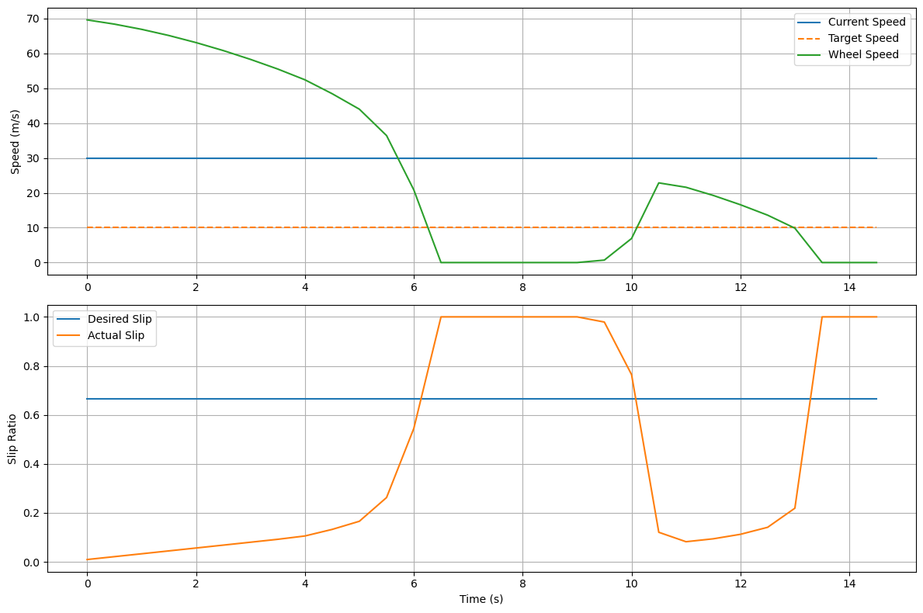
Python Code with FmPy
Plotting Results:
Wheel’s speed and the desired_slip vs. the actual_slip were plotted over time to help visualize the dynamics of the system

Slide 18
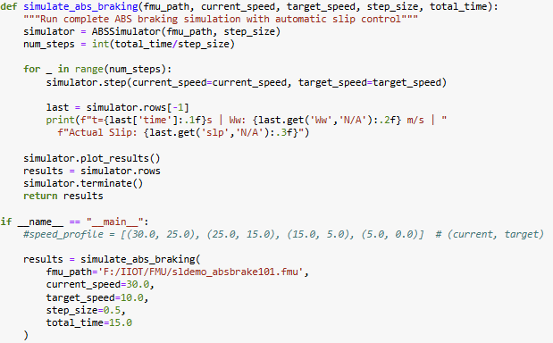
Main Simulation Execution
Initialize the ABSSimulator instance with the specified FMU file and simulation parameters (current_speed, target_speed, total_time, step_size)
Calls step() function to loop until the total simulation time is reached
plot_results() displays system behavior
Cleans up by terminating the FMU instance and removing temporary files

Slide 19
04
Carla Simulation

Slide 20

Carla - The Digital twin
What is Carla?
Our goal:
CARLA is an open-source simulator for autonomous driving research, offering realistic urban environments and sensor suites for testing and development.
- Main goal is for carla to be the digital twin in our system
- Carla is used to simulate our Smart braking system

Slide 21
How it’s integrated
ROS2
ROS2 Carla Bridge
Carla
Installed via WSL2
This ROS package enables two-way communication between ROS and CARLA by translating CARLA data into ROS topics and ROS messages into CARLA commands.
We use a carla Version that allows custom scenarios such as inserting pedestrians, stop-signs

Slide 22
Carla’s Inputs/Outputs
Outputs
Input
Camera frame readings
Current speed
Throttle pressure

Slide 23
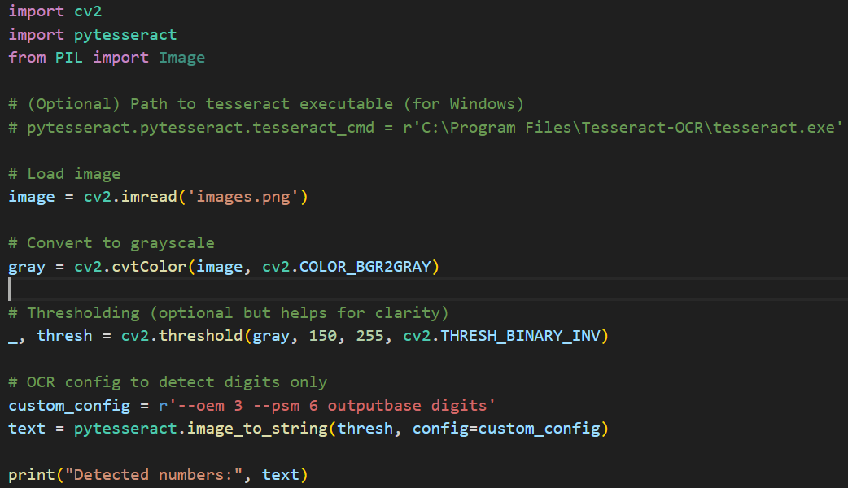
Speed Limit OCR Detector
Using Tesseract Library to read the number of the speed limit sign to send it to the FMU

Slide 24
05
Integration

Slide 25
Main Modules to Integrate
Main Components:
CARLA for simulation
ROS running on a Windows machine working as the main system coordination hub
ROS working on Raspberry Pi
Physical camera connected to Raspberry pi
Cloud Computing using Microsoft Azure

Slide 26
Main Workflow
The workflow sends
the ego vehicle status (vehicle speed)
and the images from the camera sensor
to the ROS on the Windows machine
Then the data is sent to ROS on the windows machine that run an algorithm to classify objects in the street (passengers, vehicles, or signs), run an image detection algorithm to get the speed limit from the signs in the street, and to run the FMU to calculate the control vehicle speed.
Then the vehicle control signal is sent back to CARLA, Raspberry pi and also send to it the cloud.
Also the classified images are sent to the cloud where each images is sent with the events indicating to the detected object, and the speed limit if detected and the timestamp.
We faced a problem in connecting the components as CARLA Python API cannot be built on Raspberry Pi for current versions of CARLA (0.9.15) and ROS (Humble)

Slide 27
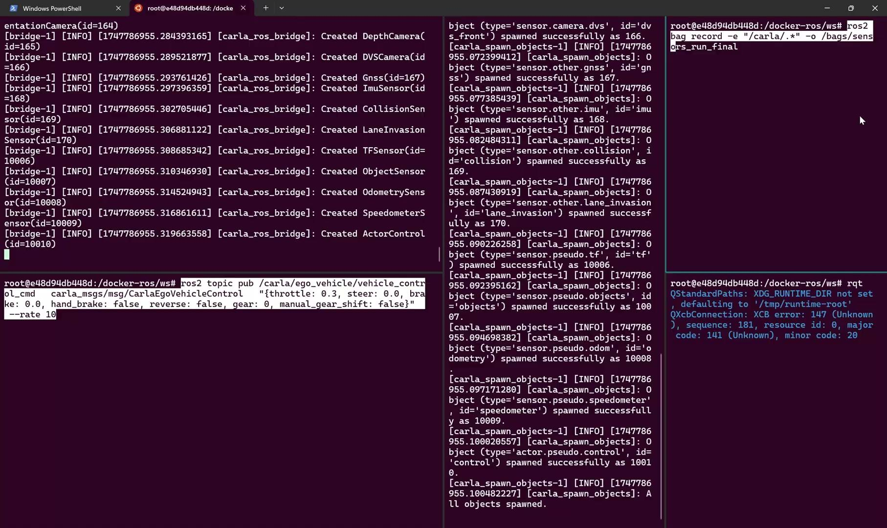
Current Progress Demo

Slide 28
06
Cloud - Connect

Slide 29


Overview
What is Cloud ?
Our goal:
The cloud plays a critical role in digital twins by providing scalable infrastructure, real-time data processing, and seamless integration across devices and systems, enabling accurate simulation and predictive insights.
1- Develop a vision model that can be used to make control decisions given input.
2- Log these events into Azure for analysis and recording.

Slide 30
Possible ML Implementations
Haar Cascades
DL models
We experimented with using Haar cascades and found that they performed reasonably well for the simple task of detecting humans in controlled scenarios. Our takeaway is that Haar cascades can be a viable option when an extremely lightweight face detection module is required.
We did a small literature survey that yielded the same results as we expected, YOLO is still the best vision model to use.
We thus checked for pre trained open-source models that are trained on road signs.

Slide 31
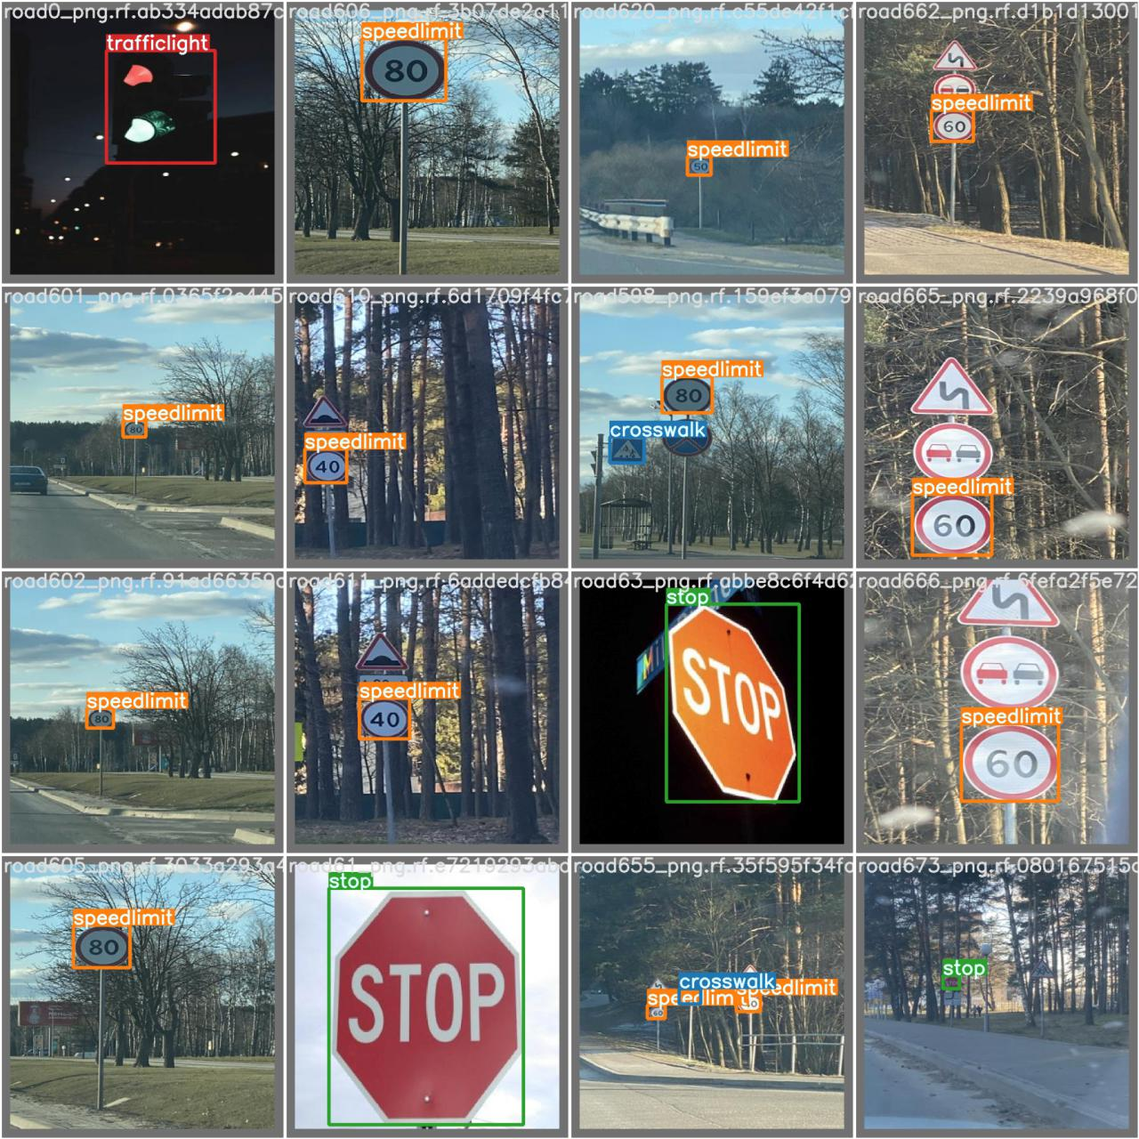
YOLO-V5
Model is lightweight and can work on CPU/GPU
13 MB
7M parameters
Trained on different labels/types of road signs
Stop, Speed limit , …
Supports video, image and Camera stream as inputs`
https://github.com/Anant-mishra1729/Road-sign-detection

Slide 32
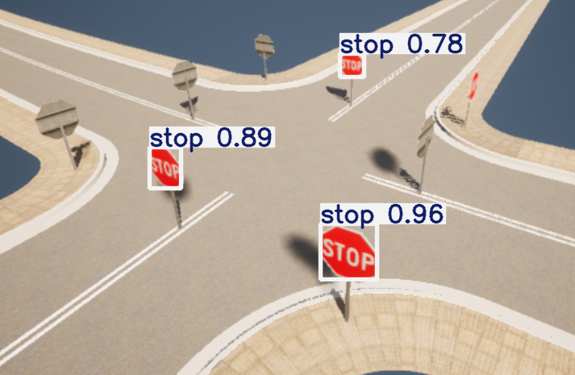
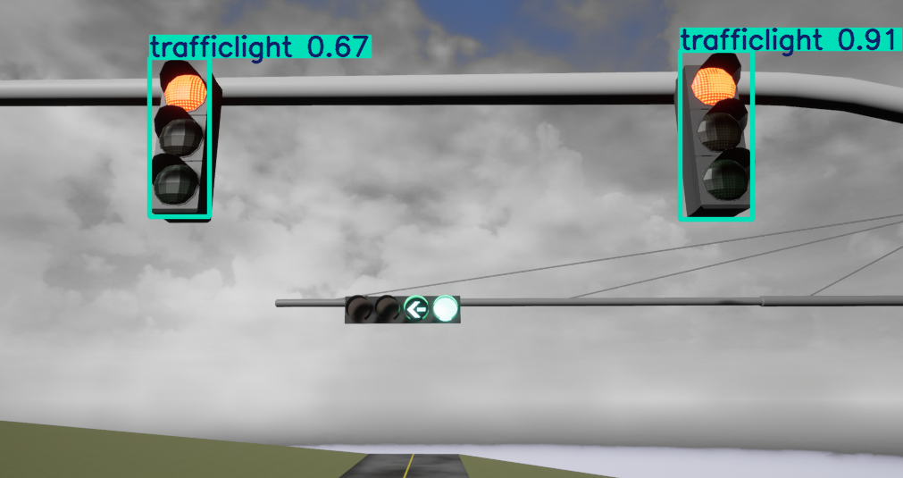
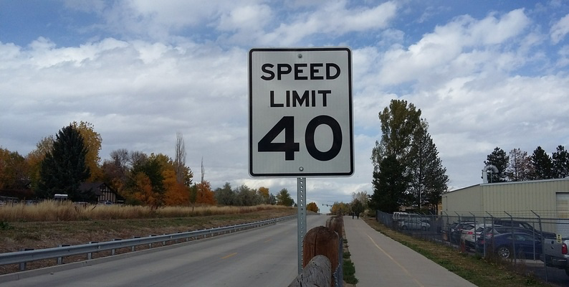
It also works on Carla … almost?
This makes sense, as Carla is based on UE4/5 which supports real-life like graphics.
Traffic lights are universal looking
However, for the default speed-signs, we noticed that it depends on from where the objects were obtained.

Slide 33
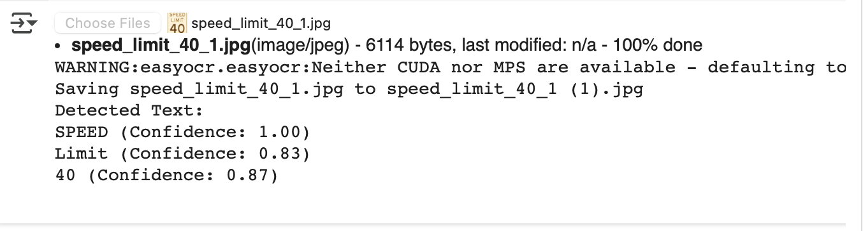
OCR Solution as a safety-net
This implementation uses the easyocr library
The only “hyperparameter” is the expected language that the sign is in

Slide 34
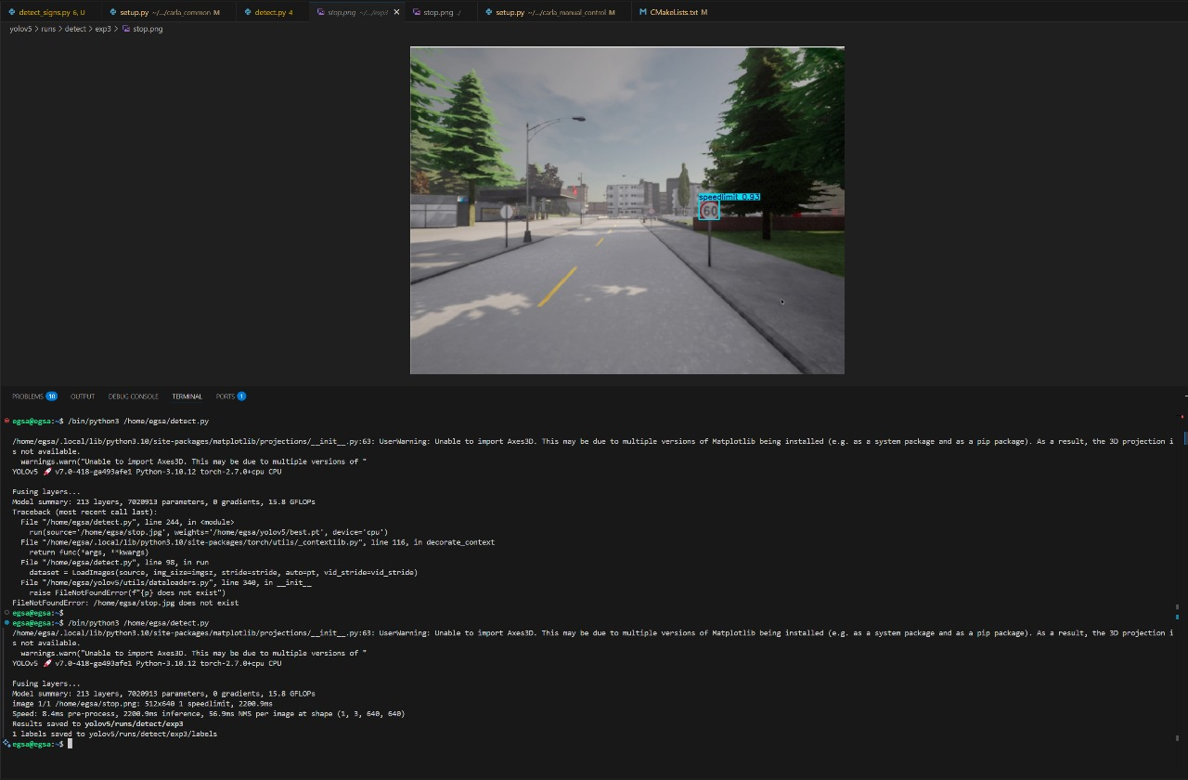
Example from project

Slide 35
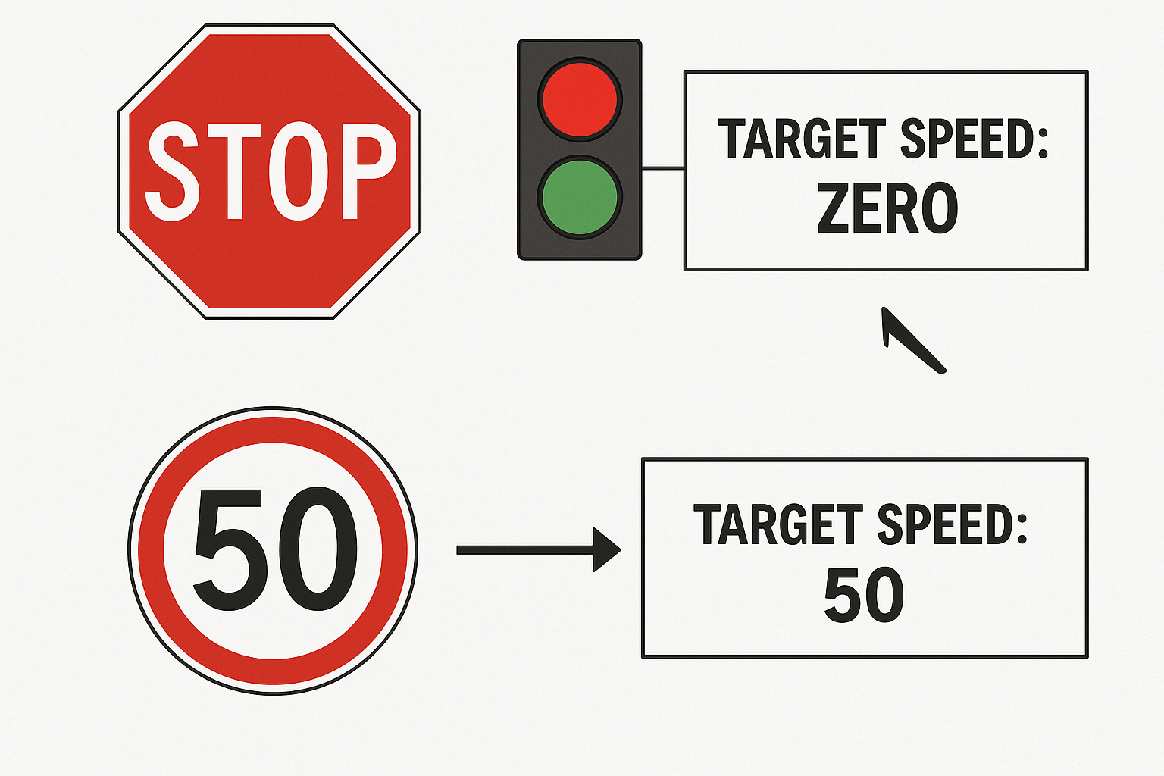
Integrating with the break pipeline
1- Detect the Stop sign/ Red light in traffic lights → Set the target speed to Zero.
2- Detect the speed limit sign → Set the target speed to the speed limit shown in sign
FMU

Slide 36
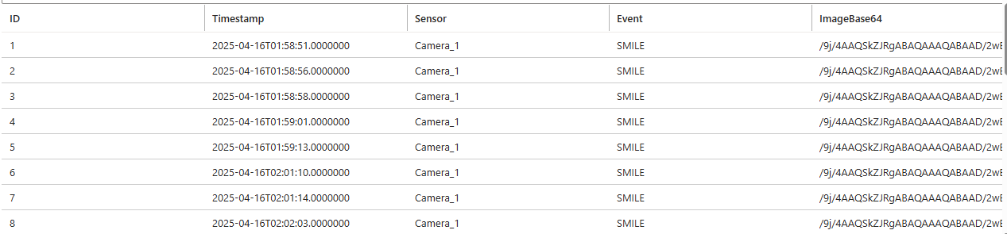
Saving Data to Azure
Azure saves for each prediction:
ID → Automatically generated by Azure
TimeStamp → Can be used to gain insights of when the car started to reduce its speed and actual stoppage to create meaningful simulation scenarios later
Sensor → Whether the prediction is from Carla or Physical twin
Image Base64 → Encoding of the image to be viewed for debugging purposes.

Slide 37
Thanks!
Do you have any questions?
Please keep this slide for attribution

